Slide 1
Project Update – Week 7
Tora Gao, Zheng Shi, Leon Zhang

Slide 2
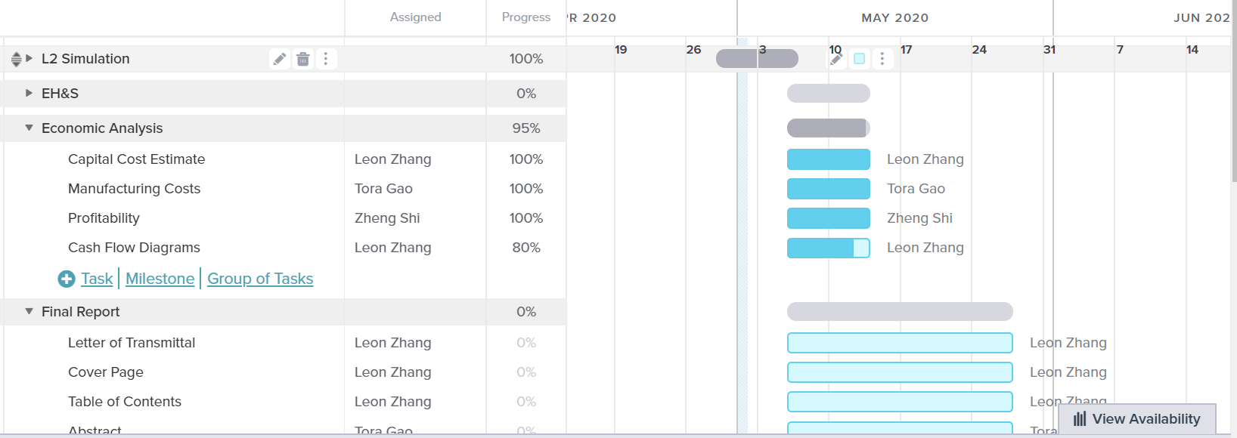
Gantt Chart
Notes:
https://prod.teamgantt.com/gantt/schedule/?ids=2115888#&ids=2115888&user=&custom=&company=&hide_completed=false&date_filter=&color_filter=

Slide 3
Tasks Completed
L2 stuff
Sizing of equipment
Most economic analysis
Capital cost, manufacturing cost, utility cost, etc.
Most waste treatment plan
Found cost estimate/correlations for ammonia storage tanks

Slide 4
Unexpected hurdles and Potential Solutions
Unexpected Hurdles:
Not unexpected but our process is very unprofitable
Potential Solutions:
Potentially optimize process to reduce costs and talk about ideas/suggestions/reasons for why the process is unprofitable and how we could improve it in the future

Slide 5
Short-Term and Long-Term Plans
Short-Term
Work on final report
Long-Term
Finish final report
Work on presentation

